Slide 1
Microsatellite Instability Classification by NGS

Slide 2
Microsatellite Instability
Characterized by the “spontaneous loss or gain of nucleotides from repetitive DNA tracts”
Caused by defective mismatch repair
Is a diagnostic phenotype for certain cancer types with clinical implications
Actionable marker for immune-checkpoint-blockade therapy
(Hause et al. 2016)

Slide 3
Sample
602 BAM/BAI files from patients in TCGA
241 Colon/Rectal/Colorectal Adenocarcinoma
361 Uterine Endometrial Carcinoma
Annotated with MSI-PCR result
MSS
MSI-L, MSI-H
27 representative loci gathered from literature

Slide 4
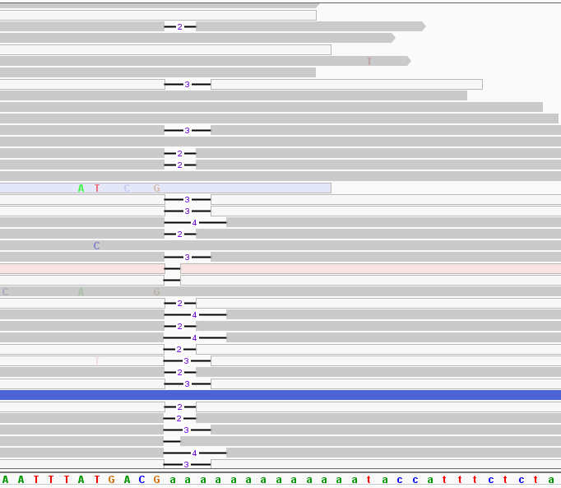
Repeat Identification

Slide 5
Repeat Identification
Flanking regions
7 bases long
Long enough to be unique, identifiable
Short enough to maximize usable reads
Immediately adjacent to the mononucleotide repeat

Slide 6
Repeat Identification
Scan and find flanking regions
Ordered search
Brute-force fuzzy matching
Mismatch allowance = 2
Validation: filter
Baseline = 90%
Modified for some loci

Slide 7
MSI Calling
Binary classifier
Simplification of MSI-H and MSI-L
Optimization
Accuracy
Sensitivity
Specificity
Locus-based calls
More common in literature
Overall MSI call based on all 27 loci

Slide 8
Machine Learning Approach
TensorFlow
Python API developed by Google
Minimize error in linear function, apply sigmoid curve to calculate p(MSI)
Simplification
5 loci with high number of BAMs with reads available, good depth at the loci

Slide 9
Datasets
All files
602 BAM files with MSS, MSI-L or MSI-H annotation
241 COAD-READ, 361 UCEC
212 MSI, 390 MSS
Mode training set
Randomly generated set of 100 BAM files with MSS status to generate mode length
43 COAD-READ, 57 UCEC
0 MSI, 100 MSS

Slide 10
Datasets (continued)
Training Set
300 BAM files of mixed status to train the model
118 COAD-READ, 182 UCEC
130 MSI, 170 MSS
Validation Set
100 BAM files of mixed status to validate the model
44 COAD-READ, 56 UCEC
40 MSI, 60 MSS
Test Set
102 remaining BAM files of mixed status to test the model
36 COAD-READ, 66 UCEC
42 MSI, 60 MSS

Slide 11
Datasets (continued)
Randomly generated sets
Representative of both cancer types
Low coverage problem
Low coverage at certain loci excludes some files from some locus analyses
Actual size of datasets vary based on individual BAM coverage at any given locus

Slide 12
MSI Calling - Features
Number of lengths
[11, 12, 11, 13, 14] = 4
Distance from mode
Average distance from MSS sample mode of all reads
Standard deviation
Average Length

Slide 13
Locus-Based Calling
Generate ML model for each locus individually
Weight for each feature, bias
Sigmoid activation function to generate a probability (0, 1)
Choose loci with highest AUC
Exclude those that have no reads in many BAM files
Try different combinations of loci
Determine MSI status based on number of loci with ‘MSI’ call

Slide 14
Locus-Based Calling (continued)
Loci examined
BAT-26
MSI-07
MSI-09
H-06
MSI-06
MSI-04
HSPH1-T17
Threshold: 0.500000
Min no. loci: 3
Total files: 93
Correct predictions: 78
True pos: 24
True neg: 54
False pos: 2
False neg: 13
Accuracy: 0.838710
Sensitivity: 0.648649
Specificity: 0.964286

Slide 15
Probability-Based Calling
Generate ML model for each locus individually
As before
Choose loci with highest AUC
As before
Determine MSI status based on average p(MSI) across loci examined

Slide 16
Probability-Based Calling (example)
BAM file: TCGA-00-0000
BAT-26
p(MSI) = 0.998
MSI-07
p(MSI) = 0.488
MSI-09
p(MSI) = 0.478
H-06
p(MSI) = 0.499
MSI-06
p(MSI) = 0.898
MSI-04
p(MSI) = 0.978
HSPH1-T17
p(MSI) = 0.408
Locus-based call: MSS
3 MSI, 4 MSS
Probability-based call: MSI
Avg p(MSI): 0.678

Slide 17
Probability-Based Calling (continued)
Loci examined
BAT-26
MSI-07
MSI-09
H-06
MSI-06
MSI-04
HSPH1-T17
Threshold: 0.500000
Min no. loci: 3
Total files: 93
Correct predictions: 78
True pos: 23
True neg: 55
False pos: 1
False neg: 14
Accuracy: 0.838710
Sensitivity: 0.621622
Specificity: 0.982143

Slide 18
Probability-Based Calling (continued)
Problem: some loci may be more indicative of MSI status than others
Need weights assigned to each locus individually

Slide 19
A Bigger ML Problem
Solution: instead of individually looking at one locus with m features, consider all n loci with all m features at once
Machine learning problem in n x m dimensions
Exclude loci with too few usable files

Slide 20
Computational Cost
21 loci x 4 features each
84-dimension model
L1 regularization
Drives weights of non-influential features to 0
Minimizes the number of features that contribute to the model

Slide 21
Machine Learning v2 - Sets
Training Set
124 MSI, 142 MSS
Validation Set
33 MSI, 52 MSS

Slide 22
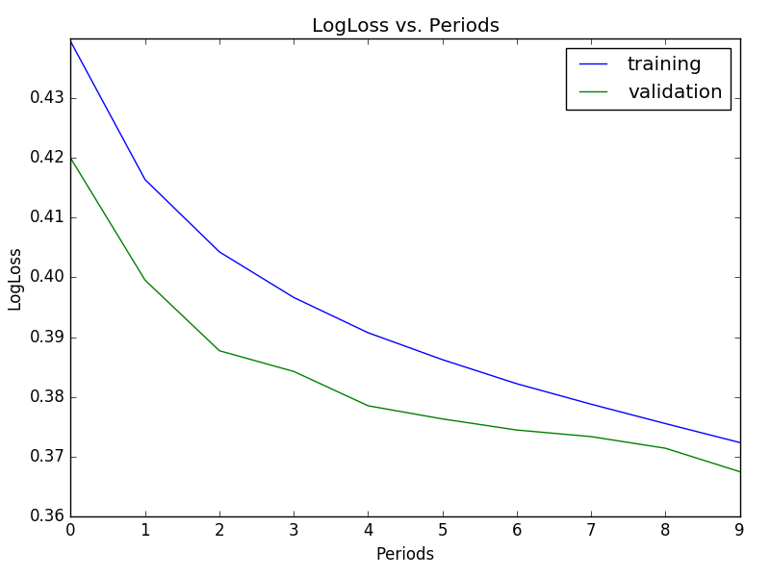
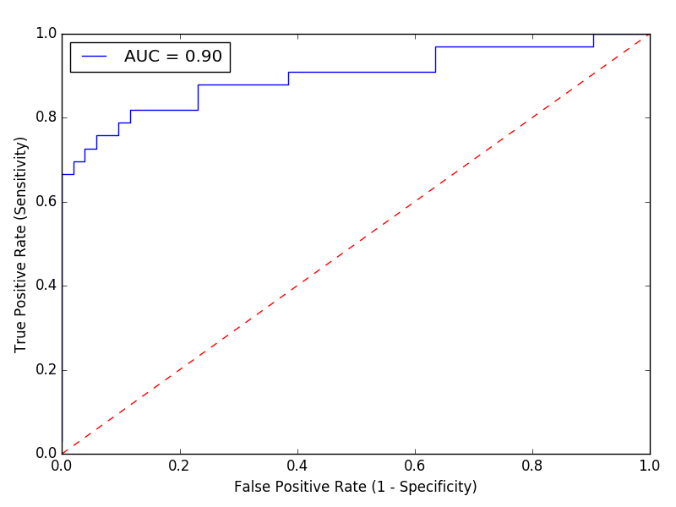
Machine Learning v2 - Results

Slide 23
Machine Learning v2 – Test Set
Loci examined
MSI-11
MSI-14
H-10
HSPH1-T17
BAT-26
BAT-25
MSI-04
MSI-06
MSI-07
MSI-01
MSI-03
MSI-09
H-09
H-08
H-01
H-03
H-02
H-04
H-07
H-06
H-05
Threshold: 0.500000
Total files: 85
Correct predictions: 73
True pos: 27
True neg: 46
False pos: 6
False neg: 6
Accuracy: 0.858824
Sensitivity: 0.818182
Specificity: 0.884615

Slide 24
Machine Learning v2 – Test Set
Loci examined
MSI-11
MSI-14
H-10
HSPH1-T17
BAT-26
BAT-25
MSI-04
MSI-06
MSI-07
MSI-01
MSI-03
MSI-09
H-09
H-08
H-01
H-03
H-02
H-04
H-07
H-06
H-05
Upper threshold: 0.550000
Lower threshold: 0.450000
Total files: 85
Indeterminate files: 9
Predictions: 76
Correct predictions: 67
True pos: 25
True neg: 42
False pos: 3
False neg: 6
Accuracy: 0.881579
Sensitivity: 0.806452
Specificity: 0.933333
Indeterminate: 10%

Slide 25
Summary
Maximum accuracy of 88% on test set
10% labeled as ‘Indeterminate’
Machine learning using all loci and all features is most:
Accurate
Sensitive/Specific

Slide 26
Further Investigations
Add a label for ‘MSI-L’ and ‘MSI-H’
Research clinical relevance of MSI diagnosis
Fine-tune parameters to favor either false positives or false negatives
Add features
Earth mover distance
Regularization
L2 regularization
Penalizes any weight that is too large, drives weights asymptotically to 0
L1 regularization
Penalizes total weight of all features, drives non-informative weights to 0

Slide 27
Further Investigations (continued)
Get more BAM files
Training, validation and test sets are stale
Get BAM files with better coverage for more accurate results, better prediction
Make a more complex model
Synthetic features
Feature crosses
Neural Nets
More complex models require additional samples to train, validate and test

